Slide 1



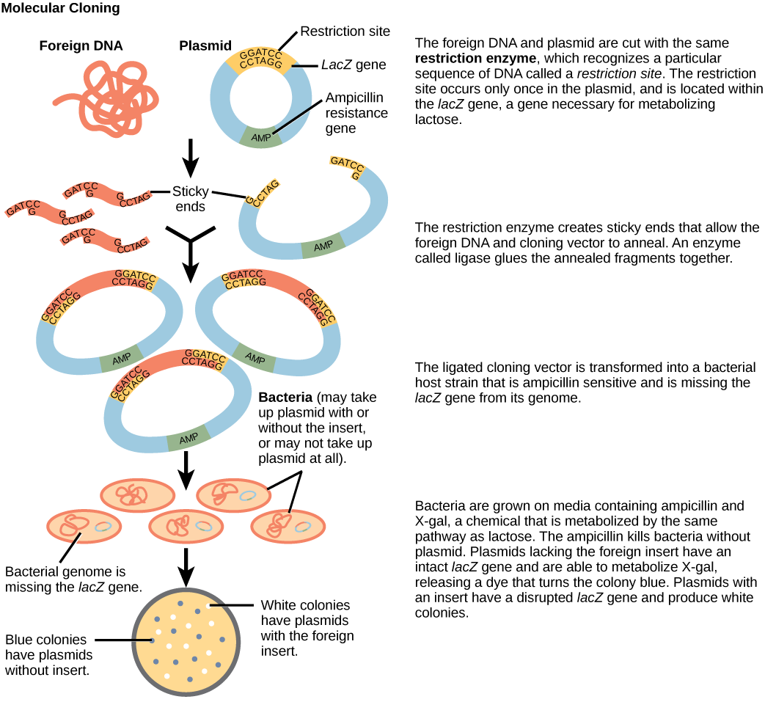

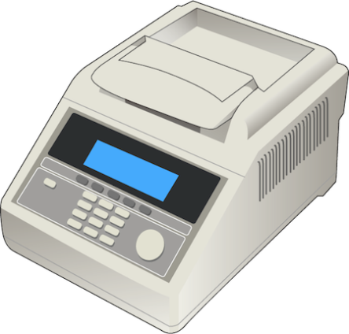
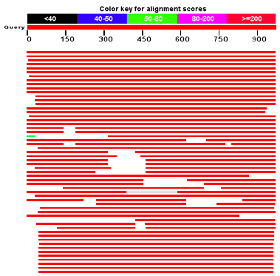
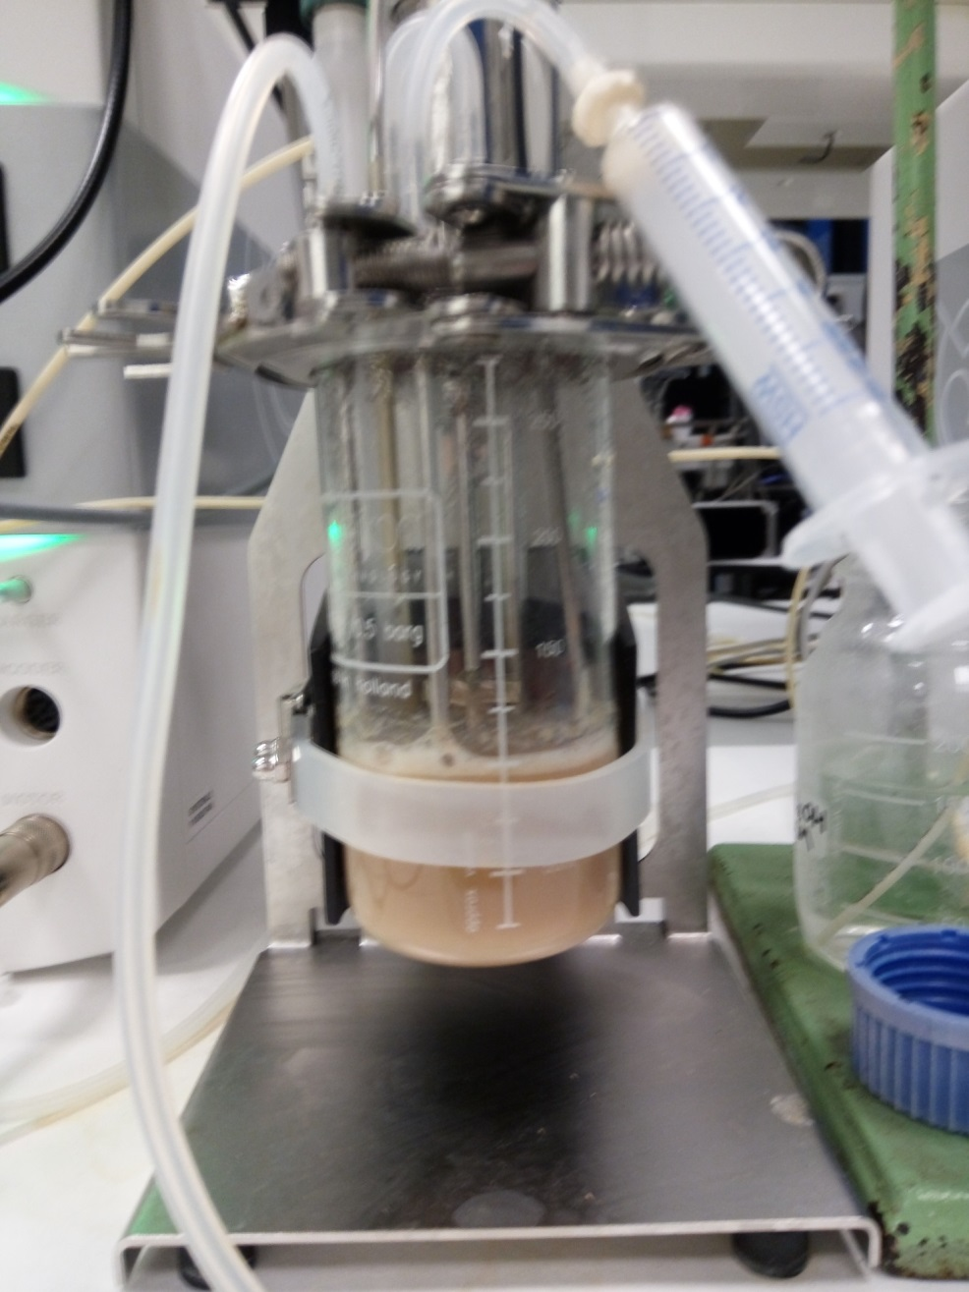
FROM GENEs towards industry:
discovery of A panel of new thermostable self-sufficient cytochrome P450s and application FOR the whole-cell 5-hydroxylation of diclofenac
Michele Tavanti*, Joanne L. Porter*, Colin W. Levy, Selina Sabatini, Rowan M. Lindeque†, Mafalda Dias Gomes†, J. Rubén Gómez Castellanos, John M. Woodley†, Nicholas J. Turner* and Sabine L. Flitsch*
†Department of Chemical and Biochemical Engineering, Technical University of Denmark (DTU), 2800-Lyngby, Denmark
*School of Chemistry, Manchester Institute of Biotechnology. The University of Manchester. UK.
Email: nicholas.turner@manchester.ac.uk or sabine.flitsch@manchester.ac.uk
The ability of cytochrome P450 monooxygenases to catalyse a wide variety of synthetically challenging oxidation reactions makes them highly desirable biocatalysts. The most common P450 catalysed reactions are monooxidation reactions (e.g. hydroxylations, heteroatom oxidations or epoxidations) using a single oxygen atom from molecular oxygen, with the other oxygen atom reduced to water. Two electrons supplied by NAD(P)H are shuttled following productive interaction with redox partners to enable molecular oxygen activation. Despite their immense potential, P450s are plagued by issues associated with poor expression, solubility and stability, particularly in recombinant systems.^{[1]} Genomes of thermophilic and hyperthermophilic organisms have been investigated in order to discover biocatalysts with desirable properties,^{[2-5]} placing a major focus on the heme domain only, while P450 chemistry depends also on the effective supply of reducing equivalents from redox partners, that need to match the stability of the heme domain. Efforts to engineer mesophilic P450s have been done^{[6,7]} but to date, no natural thermophilic self-sufficient P450s have been characterised. We have identified, cloned and expressed five new class VII P450s (Figure 1), demonstrating that this new panel of enzymes outperforms the mesophilic homologue P450 RhF in all aspects investigated. ^{[8]}
Structure determination and thermal stability
Figure 1. Discovery, cloning and expression workflow. The structural organisation of class VII P450s is shown on the right.
Thermal stability of the P450s was measured in two ways, determining the percentage of active P450 by formation of the Fe(II)-CO complex at 450 nm and by monitoring the residual activity toward 7-methoxycoumarin (Figure 2B). Each of the P450s from this study displayed greater thermal stability than RhF, which was encouraging given the previous issues with stability of P450-RhF. In particular AX, TB and TT showed significant improvements with increases in T₅₀ of greater than 15 °C. Discrepancies between the observed T₅₀ values for the residual CO binding and the residual activity, can likely be attributed to a less stable reductase domain.
In order to provide a link between the sequence and the 3D structure of this valuable class of enzymes, we solved the first X-ray structure of the P450 domain of a class VII P450 (Figure 2A). As thermally stable enzymes tend to generate protein crystals better suited for X-ray diffraction, we focused on P450-TT (CYP116B46) to get a first insight into the structure of this class of self-sufficient enzymes. Overall, P450-TT adopts the triangular P450 fold and shows similarity to enzymes capable of oxy-functionalization of fatty acids, terpenes, macrolides, steroids and statins. Even though the structural basis for thermal stability could not be established, the insight gained from solving this structure will provide a guideline for future engineering and modelling studies on this catalytically promiscuous class of enzymes.
A
B
Figure 2. (A) P450-TT overall fold with helices represented in cyan, β-strands in red and coils in magenta. (B) Thermal stability of P450s determined by the residual activity toward 7-methoxycoumarin following incubation at elevated temperature for 15 min.
A diverse substrate scope
Whole cell biotransformations of diclofenac
The newly identified P450s were screened for activity towards a panel of 11 substrates and a range of activity was observed including demethylation 4-methyoxyacetophenone derivatives, 4-methoxybenzophenone, 4-methoxybenzonitrile, epoxidation, hydroxylation, and sulphoxidation (Figure 3). Previously P450-RhF has been shown to possess good activity towards diclofenac and produce the human metabolite 5-hydroxydiclofenac.^{[9]} In this study P450-AT, AX, JT and TT all displayed better conversions (> 95 %) to the hydroxylated product than RhF (63 %) under the screening conditions. Furthermore in terms of total substrate conversion, RhF was outperformed in all cases by two or more of the new class VII P450s from this study, with the exception of just α-isophorone where no activity was observed with any P450. The sulphoxidation capability of AT, AX, JT, TB and TT was demonstrated with methyl phenyl sulphide to give conversions of 59, 34, 58, 58 and 21 % respectively to the corresponding sulphoxide. Epoxidation activity was also demonstrated using styrene as substrate with conversions of 10-20 % to the corresponding epoxide catalysed by AT, JT and TB.
Diclofenac metabolites are persistent environmental contaminants but they are not readily available for toxicology study or environmental analysis due to the difficult chemical synthesis. Here our initial screening experiments suggested that the present thermostable enzymes would be significantly better than P450-RhF at catalysing 5-hydroxydiclofenac production. In particular, P450-AX proved to be the best biocatalyst to carry out this biotransformation. Scale-up experiments carried out in shake flasks demonstrated significant improvements when compared to the previously reported metrics for the P450-RhF catalysed whole cell system.^{[9]} To expose the biocatalyst to more industrially relevant conditions, scale-up experiments were also carried out in a stirred tank reactor (Figure 4). Our experiments demonstrated that the reaction was limited by the supply of oxygen. Process optimization in terms of agitation and oxygen supply led to more than 2-fold improvement in relevant metrics such as product concentration and biocatalyst yield.
 | Oxygen supply
Process metric | Pure O₂ | Air
Scale (mL) | 100 | 100
Substrate load (mM) | 5 | 5
Process time (h) | 6 | 6
Reaction conversion [%] | 94 | 38
Product concentration [g/L] | 1.5 | 0.6
Max STY [g L⁻¹ h⁻¹] | 0.62 | 0.24
Biocatalyst loading [g_{cww}/L] | 125 | 125
Biocatalyst yield [g_{product}/g_{cww}] | 0.012 | 0.0048
Figure 3. Catalytic versatility of the newly discovered panel of thermophilic self-sufficient P450s.
References
[1]: E. O’Reilly, V. Kohler, S. L. Flitsch and N. J. Turner, Chem. Commun., 2011, 47, 2490–2501.
[2]: A. V. Puchkaev and P. R. Ortiz De Montellano, Arch. Biochem. Biophys., 2005, 434, 169–177.
[3]: A. V. Puchkaev, T. Wakagi and P. R. Ortiz de Montellano, J. Am. Chem. Soc., 2002, 124, 12682–12683.
[4]: A. Schallmey, G. Den Besten, I. G. P. Teune, R. F. Kembaren and D. B. Janssen, Appl. Microbiol. Biotechnol., 2011, 89, 1475–1485.
[5]: T. Mandai, S. Fujiwara and S. Imaoka, FEBS J., 2009, 276, 2416–2429.
[6]: Y. Li, D. A. Drummond, A. M. Sawayama, C. D. Snow, J. D. Bloom and F. H. Arnold, Nat. Biotechnol., 2007, 25, 1051–1056.
[7]: S. Eiben, H. Bartelmäs and V. B. Urlacher, Appl. Microbiol. Biotechnol., 2007, 75, 1055–1061.
[8]: M. Tavanti, J. L. Porter, S. Sabatini, N. J. Turner and S. L. Flitsch, ChemCatChem, 2018, doi:10.1002/cctc.201701510
[9]: J. M. Klenk, B. A. Nebel, J. L. Porter, J. K. Kulig, S. A. Hussain, S. M. Richter, M. Tavanti, N. J. Turner, M. A. Hayes, B. Hauer and S. L. Flitsch, Biotechnol. J., 2017, 12, 1600520.
Figure 4. Whole-cell 5-hydroxylation of diclofenac by P450-AX. The table shows a comparison between the calculated process metrics obtained from experiments carried out with different oxygen supply methods. The bioreactor employed is also shown. Stirring was set at 200 rpm and pure oxygen/air was supplied at 0.2 vvm.
Acknowledgments
“The research for this work has received funding from the European Union (EU) project ROBOX (grant agreement n°635734) under EU’s Horizon 2020 Programme Research and Innovation actions H2020-LEIT BIO-2014-1” .

